Slide 1
Repetition For Loops
ICS 3U0

Slide 2
Today’s Agenda
Repetition with the for loop

Slide 3
Repetition
One of the greatest strengths of computers is their ability (and willingness) to do the same task over and over again.
In addition, the computer will always perform the task in exactly the same way for the same input, provided the programmer (you!) has done their job correctly.

Slide 4
Repetition - Example
Suppose we wanted to output the numbers from 1 to 10, in order, on the screen. How could we do this? How does efficiency affect how we would do it?
What if we wanted to count to 100? 1000? Would that change our strategy?

Slide 5
For Loops
The simplest form of repetition is called a loop, and the simplest type of loop is the for loop.
In a for loop, we execute some segment of code a fixed number of times.
In English, we might say: “Do something 10 times”

Slide 6
Are We Done Yet?
If we are going to perform a task a fixed number of times, we need to keep a count so we know when we're done.
Since counting involves whole numbers, we use an integer variable as our counter. Try to pick a meaningful name for the counter.

Slide 7
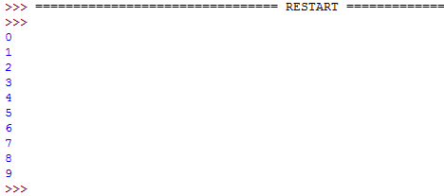
The For Loop
The counted loop is so common that a special type of loop was created to streamline the code. In Python, the keyword for counted loop is for. Consider these examples.
for x in range(0,10,1):
print(x)
for y in range(0,10):
print(y)
for z in range(10):
print(z)
What do you think the output will be on the screen?
Preferred way to do this!

Slide 8
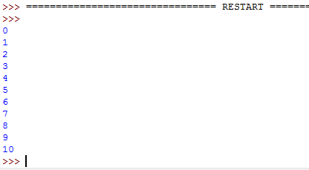
The For Loop
In all three cases, the program printed the values 0 through 9 to the screen.
This illustrates an important point about range — it does not include the specified stop value. This means that if we want to include 10, we need to use the following code.
for count in range(11):
print(count)

Slide 9
Changing the Step
So far, we have counted in the for loop by one. It is possible to take larger steps using a further argument in the range:
for count in range(0,11,2):
print(count)
This is the step
This would display the values 0, 2, 4, 6, 8 and 10. Remember that 11 is not included in the range.

Slide 10
Counting Down – For Loop
When we count upwards, the counter is incremented (i.e., we add 1 each time). To count downward, use a negative value for step. To count down from 10 to 1, use the following code.
for num in range(10,0,-1):
print(num)
Again, the stop value is not included, so using range (10, 1, -1) would print the values 10 through 2 only.

Slide 11
Things to Know
Any code that is not included inside of the loop will not be repeated. The following two examples produce different results. Run them both and see what happens.
for x in range(8):
print("hello")
print("there")
for x in range(8):
print("hello")
print("there")
These print statement are INSIDE the for loop – both get executed 8 times
This print statement is OUTSIDE the for loop – it only gets executed once

Slide 12
Control Counting with Variables
The upper and lower bounds for the counter can also be variables.
low = int(input("Count from? "))
high = int(input("Count to? "))
for count in range(low,high):
print(count)
What do you think the output will be if the input was 6 and 17?

Slide 13
Exercises – Repetition
Open Exercise 3.1 – Day 1 Repetition – For Loops

Slide 14
Warm Up – Day 2
Output the times-tables (from 1 to 12) for whichever number the user requests. For example, if the user enters 3, your output should be:
1 x 3 = 3
2 x 3 = 6
...
12 x 3 = 36
Once this is working, allow the user to specify the start and end to the table (e.g., times-tables from 4 to 15)

Slide 15
Accumulating Values
In many applications, we want to find the total amount of some quantity.
For example:
adding student grades
cash register totals
scoring a game

Slide 16
Example – Adding Three Numbers
sum = 0
print("This program will add 3 integers")
for i in range (3):
num = int(input("Enter number: "))
sum += num
print("The sum is ", sum)

Slide 17
You Try!
Write a program that asks a user to enter whether they won (W) or lost (L) each of their last last ten games. Assume there were no ties. Output to the user the total number of wins and the total number of losses.
Input:
Enter result of game (W) or (L): W
Enter result of game (W) or (L): L
...
Output:
You won 7 game(s).
You lost 3 game(s).

Slide 18
Exercises – Repetition
Open Exercise 3.1 – Day 2 Repetition – For Loops

Slide 19
Warm Up – Day 3
Write a program to display all the numbers divisible by 17 between 1 and 100. The expected output is: 17 34 51 68 85.
When this is working, modify the program to allow the user to change the number 17 to anything they want. Check to make sure that the number they chose is between 1 and 100.

Slide 20
Exercises – Repetition
Open Exercise 3.1 – Day 3 Repetition – For Loops

